Slide 1
Gifts Inside of ME
(Sunday School Model, Ages 3-5)
Training Session for Staff and Volunteers
A Young Children's Study (through Song), of the fruits of the Spirit (Galatians 5:22-23)
Instructor: Nancy Holden

Slide 2
Gifts Inside of Me!
Introduction
Thank you so much for being part of our Sunday School Training for young children. We appreciate that you will be part of this amazing experience, and we look forward to co-creating fun songs and lessons with all of you to glorify God.
I thought it might be easier to send you this training presentation via email, so that you could have a chance to enjoy the training in the convenience of your home, as I know how busy life can get. We appreciate that you will be part of our Sunday services and are grateful for all that you do to help our children. (Please put January 3rd at 12pm in your calendar to join us for our special staff and volunteer luncheon in your honor!)
I hope that after you read through the training and view the songs, that you may have some ideas on areas that you would like to be part of. Perhaps you enjoy playing the ukulele? Piano or Violin? Sing, write poetry or songs? Maybe you enjoy creating art projects? We would like to include your own personal talents and passions with the lessons for the children, so please jot down a few notes after reading this on the form provided, and when we have our staff/volunteer lunch next week, we can add your ideas to the lessons!

Slide 3
Introduction (continued)
The Sunday School Model of Christian Ministry for young children ages three to five, provides imaginary games, puppet play, age-appropriate activities and songs, that help children learn about Jesus and his teachings on the fruits of the Spirit, which will build character and spiritual growth.
“Gifts Inside of ME” is a very special song and activity book that we will use as our template to help young children in our Sunday School Model. This will serve as an introduction to the stories of the Bible, as we sing and learn about the fruits of the Spirit. Children will learn that “God created them,” (Genesis 1:27) and then sent his Son, Jesus, (John 3:16,) to teach us about the special gifts inside of our hearts (fruits of the Spirit), such as love peace, patience, kindness, goodness, faithfulness, gentleness and self-control. (Galatians 5:22-23, New King James Version)
These virtues are shown in the books of the Bible and will be used starting January 1st at Sunday School during both services, to help guide young children through music and fun activities, so they can better understand God’s beautiful “Love Story”. We will study one fruit of the Spirit each month, one verse per week, learn songs for each gift and have a fun activity!
Example: Week 1: Love – Sing the song “Gifts Inside of ME”, teach about God’s love for us through his son Jesus, (John 3:16), to teach us about love, then do an activity about love.
Let’s review the lessons together, and I look forward to your input on how we can make January the best month ever for learning about God and his Son Jesus, along with the Holy Spirit, in an age-appropriate way for three- to five-year-old children.
Written with love,
Nancy Holden

Slide 4
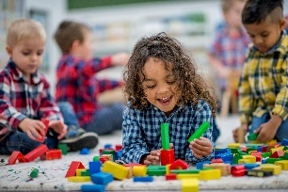
Key Elements of Sunday School Model
Understanding the Phase of the Young Child
Joiner and Ivy state: “Children might have imaginary friends, become self-proclaimed princesses, pirates, or superheroes. You might walk into a room to discover it’s really a train station, a castle, an exotic island, or all three. While that’s delightful at times, the imaginary may also turn scary. Fear may set in when at any given moment a monster can show up in the hallway, a snake can be under the bed, or a dragon can walk through the living room.”1
Take Heart!
One of the best things about this age is that everything can be a game!” 2
Children can enjoy learning, while playing, and music along with games can be a wonderful source of play for them!
1) Joiner, Reggie and Kristen Ivy, It’s Just a Phase So Don’t Miss It: Why Every Life Stage of a Kid Matters and at Least 13 Things Your Church Should Do About It (Cummings, GA: Orange Books, 2015), 17–19.
2) Ibid.
3) Ibid.
4) Ibid.
How to Help Young Children Learn? (How do we answer that fun question….Why?)
“But when a four-year-old asks why, they aren’t looking for a deep philosophical answer. They just want to know how things are happening. When they ask why the second and third times, they aren’t doubting the truth of your answer. They’re just looking for more of the wonderful knowledge they know you must have as an adult person.”3
Our Goal as Staff and Volunteers:
“Embracing them physically as toddlers when they were yearning to know they were safe and loved.
Engaging their imagination as second graders so they could discover how God’s story intersected with their story.
Affirming their worth as they transitioned through puberty and middle school toward increasingly challenging questions.
Mobilizing them to serve in high school, so they walked away never experiencing what God can do through them.”4

Slide 5
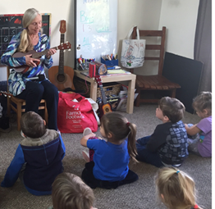
The Importance of Sunday School Model for Young Children Ages Three to Five
Phases of a Kid’s Life: Joiner and Ivy share “There are two answers to the question…
What Phase of Life is the most important?” 1
“Answer 1. The phase that should matter most is the one you are working with now. In other words, you should learn to champion the age group you work with so you can become a specialist. Specialists provide focus, and focus gives a ministry momentum and relevance. A specialist stays focused on what a kid needs now.
Answer 2 - The phase that matters most happens before AND after this phase. Effective ministries know how to focus on a specific age group and see the overall vision for a kid’s life. That means as an age-group leader you need to develop the skill to be a specialist and a generalist, simultaneously.
A generalist owns the vision for where a kid is going.”2
The Importance of Having Goals for the Sunday School Model, Ages Three to Five
“Partner with families at pivotal transitions.
Teach comprehensively from preschool through college.
Train leaders how to work with specific age groups.
Improve dialogue and cooperation between ministries.
Resource parents to interact with kids in the home.” 3
1) Joiner, Reggie and Kristen Ivy, It’s Just a Phase So Don’t Miss It: Why Every Life Stage of a Kid Matters and at Least 13 Things Your Church Should Do About It (Cummings, GA: Orange Books, 2015), 47–48. 2) Ibid. 3) Ibid., 2.

Slide 6

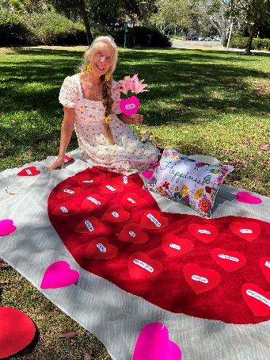
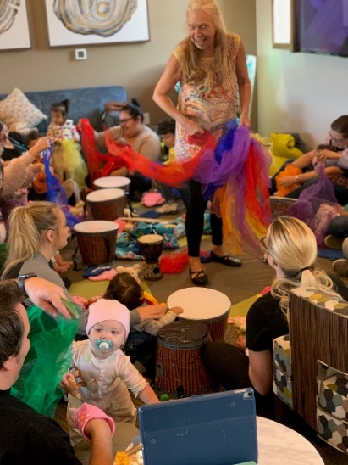
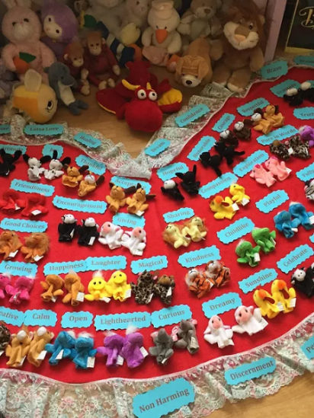
Benefits of Sunday School Model for
Children Ages Three to Five
Singing, Music, Puppet Play and Games are an excellent source to benefit young children to learn about the stories of the Bible! a first impression of a heavenly Father.” 1
Nature is filled with gifts from God and shows us how God made everything for us! We can take our classes outside and sit on the grass, give the children flowers and hearts with one of the fruits of the Spirit to learn, and then cut out our own pink hearts and draw our favorite family member that we can show love to!
If we teach children about virtues and values when they are young, these lessons will help them “form decisions they make later on, that will also become their convictions on how they live and treat others.”2
1) Joiner, Reggie and Kristen Ivy, It’s Just a Phase So Don’t Miss It: Why Every Life Stage of a Kid Matters and at Least 13 Things Your Church Should Do About It (Cummings, GA: Orange Books) Chapter 2 2) Derik Idol, “Culture and Leadership,” (video), 6.7, https://canvas.liberty.edu/courses/754577/pages/watch-married-to-a-model?module_item_id=82508196.

Slide 7

Benefits of Sunday School Model (Continued)
Joiner and Ivy tell us that every stage a child experiences, parents have less hours per day that families can spend with their children. At preschool, parents have “12 hours a day, but that decreases by 6 hours with elementary school and 2 hours a day by the time their children reach high school.” 2
The benefits of Sunday School Model is to support the parents by helping them “win” with their own kids.”
How to support and “reactivate parents:”
•“Create a content calendar with everything you want parents to know
• Organize a plan to cue parents weekly with key information when they need it
• Establish annual parent orientations to equip them for the next phase
• Recruit leaders to connect with every parent, especially those who never show up
• Provide resources to enhance family time in the home.” 3
Our role as staff and volunteers should be:
“EMBRACE their physical needs
During the preschool years parents must learn to EMBRACE their child’s tangible needs so they can begin to establish physical trust.
ENGAGE their interests
During the elementary years, parents should take a crash course in storytelling and play so they can
ENGAGE the interest of their child. This will be the best time to earn relational credit.
AFFIRM their personal journey.” 4
1) Reggie Joiner and Kristen Ivy, It’s Just a Phase So Don’t Miss It: Why Every Life Stage of a Kid Matters and at Least 13 Things Your Church Should Do About It, (Cummings, GA: Orange Books, 2015)
2) Ibid.
3) Ibid.
4) Ibid.
Joiner and Ivy share that we should:
“EMBRACE preschoolers physically, it gives a first impression of a heavenly Father.” 1

Slide 8
Biblical Support of the Sunday School Model for Young Children.
Learning about the fruits of the Spirit through song can help young children feel the presence of God inside of their hearts and learn how to treat others as Jesus taught.
(One Bible Verse each Week with Lesson Plans)
Love –John 3:16/1 Corinthians 13:4-7/Isaiah 54:20/Psalm 143:8
Joy – Philippians 4:4/1 Thessalonians 5:16-18/1 Peter 1:8/Psalm 16:11
Peace – John 14:27/Matthew 5:2/Isaiah 54:10/Psalm 94:19
Patience – Romans 12:12/Galatians 6:9/Hebrews 10:36/Psalm 37
Kindness – 1 Corinthians 13:4/2nd John 1:6/Micah 6-8/Proverbs 11:17
Goodness – Psalm 23:6/James 1:17/1 Chronicles 16:34/Romans 8:28
Faithfulness – 2 Thessalonians 3:3/1 John 1:9/Lamentations 3:22-23/Proverbs 3:5-6
Gentleness – Galatians 5:22-23/Ephesians 4:2/1 Kings 19:12/Isaiah 40:11
Self-control – 2 Timothy 1:7/Titus 2:11-12/Proverbs 16:32/Ecclesiastes 7:9

Slide 9
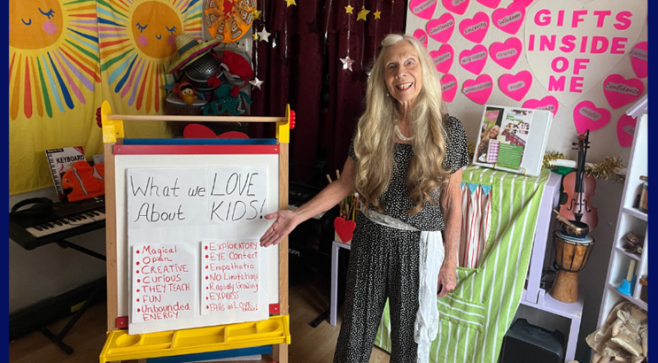
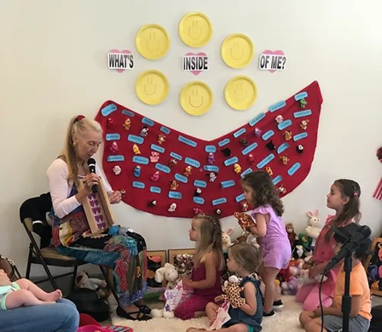
Academic Support
Providing Academic Support, resources and services to help our young children grow in their learning is very important. We are happy to share that all our staff and volunteer training will be provided as webinars and sent to weekly, so that you can learn from the comfort of your home!
We will provide these tools through instruction that can equip students with the tools that they need to understand God’s Word. The fruits of the Spirit are taught through visual aid, along with puppets, lesson plans, singing and puppet play!
Our Promise to You as Members of our Team
“Our vision statement”1 is to provide you with all the academic support that you need to feel confident, so that you can help young children learn about the love of God in an age-appropriate way.
“Our essence statement”2 is how we hope to make every child, staff member and volunteer feel important, loved and supported.
“Our mission statement”3 is that we will give every child the nurturing, loving experience so that they witness Gods love and his gifts through us, as teachers.
1) Lee Cockrell, Creating Magic: 10 Common Sense Leadership Strategies from a Life at Disney, (NY: Penguin Random House, 2008), Chapter 4. 2) Ibid. 3) Ibid.

Slide 10

Practical Ways to Implement Sunday School Model – Application points and specific actional recommendations that volunteers, or staff can use more effectively to lead
There are many virtues found in the books of the Bible, and we have corresponding bible verses for each one! Please check out the next few slides for some recommendations on bringing your own special gifts into the mix to help our young children learn about the fruits of the Spirit.

Slide 11
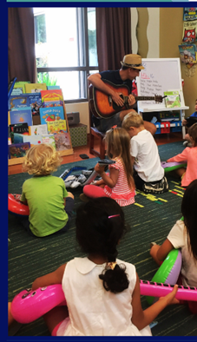
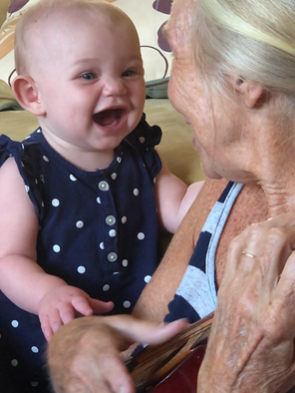
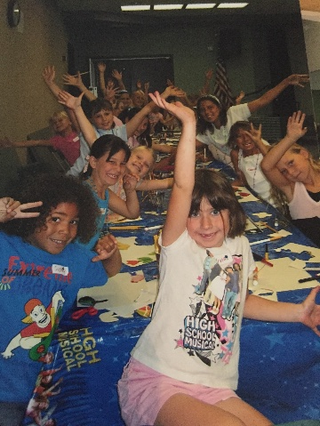
Practical Ways to Implement Sunday School Model (Continued)
“Think Like an Artist!”1
1) Reggie Joiner and Kristen Ivy, It’s Just a Phase So Don’t Miss It: Why Every Life Stage of a Kid Matters and at Least 13 Things Your Church Should Do About It, (Cummings, GA: Orange Books, 2015), 91.

Slide 12
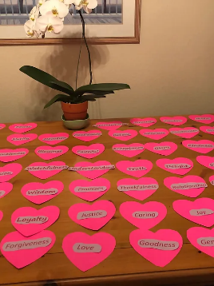
Practical Ways to Implement Sunday School Model (Continued)
Every child will learn a new virtue each month, make a design a heart with colors, stickers, etc. We have a heart template with many beautiful virtues, along with the fruits of the Spirit that are found in each book of the Bible. Children will make their own heart book and add the new virtue each month through coloring and designing
As a staff member or volunteer, please take a look at the sample lesson plans and biblical verses and let us know what you think! We would love your input and love it if you would share your own gifts with the children!
We will provide whatever support you need to bring your special gift to the children. (See next 3 slides for specific actional recommendations)

Slide 13
Practical Ways to Implement Sunday School Model – Application points and specific actional recommendations that both volunteers and staff can use more effectively to lead (Continued)
Here is the theme song we would like to sing each week, adding in the virtue we are learning about. Please visit the link to review the words! https://www.youtube.com/watch?v=B0vRhq1EktI
Gifts Inside of Me!”
I was born with gifts inside of me
To help me know just who I’m going to be
Even though I know its always up to me
I decide!
Compassion, kindness, joy and tolerance
Gratitude and love and gentleness
And even though I know its always up to me, I decide!
I decide, who I will forgive
I decide how I’m going to live
Even though I know, God’s love can make me grow,
I, I, I, I, I, I, I, I decide

Slide 14
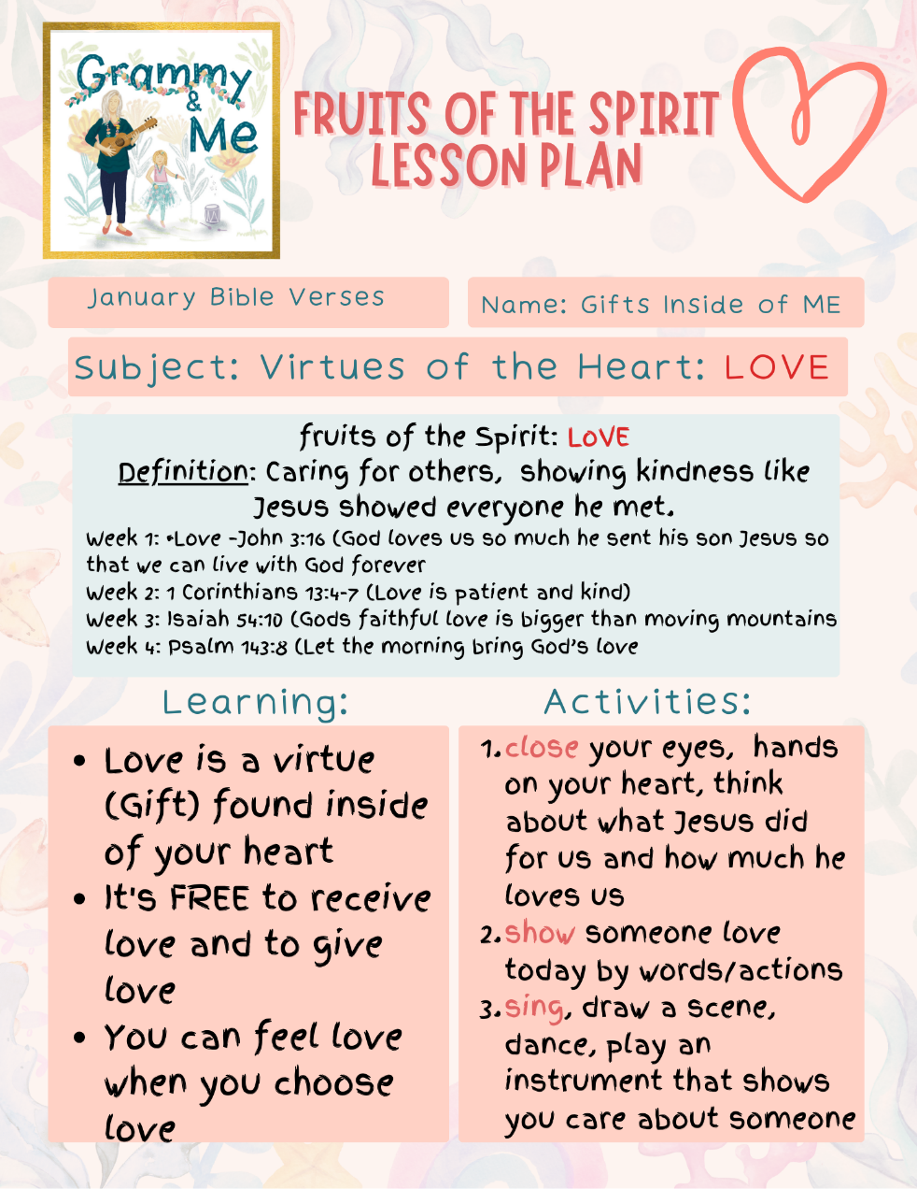
Sample Lesson Plan for the month of January, along
with our Volunteer Form! Please complete form at your convenience!
Thank you for being part of our Volunteer Staff for Sunday School Children! Here is a sample of our first month's lesson plans, and please feel free to text me at 123-45-6789 to let me know if you would what creative arts activity you would like to bring this week to class! Name________________________________________ Phone________________________________________ _____I would like to bring an instrument _____I would like to write a poem _____I would like to sing or write a song _____I would like to create a puppet lesson _____I would like the lesson plan already set _____I am available _______________________________ My passions that I would like to share are: ______________________________________________________ ______________________________________________________ ______________________________________________________ ______________________________________________________ ______________________________________________________ Please feel free to call or email n.holden7@liberty.edu for any questions or if I can help in any way! Thank you!

Slide 15

The Books of the Bible and Additional Corresponding Virtues, Values and Characteristics that the Bible Teaches:
Old Testament Bible Virtues
New Testament Bible Virtues
Communication
Understanding
Song
Prosperity
Restoration
Love
Forgiveness
Respect
Justice
Openness
Goodness
Generous
Faithful
Freedom
Glorify
Restoration
Peace
Hope
Vision
Gratitude
Humility
Acceptable
Confidence
Perseverance
Inspiration
Truth
Love
Kindness
Friendship
Mercy
Believe
Creation
Relationship
Worship
Gracious
Obedience
Trust
Compassion
Comfort
Praise
Wisdom
Promises
Thankfulness
Devotion
Caring
Joy
Helpful
Encouragement

Slide 16
Our Commitment to Staff and Volunteers:
The fruits of the Spirit will be our guideline on how we treat our wonderful Staff and Employees
Joiner and Ivy share the importance of: “Making you feel special, treat you as an individual, respect you and your children, and be knowledgeable.”1 These gifts are all fruits of the Spirit and are listed below. We have added a few of the other fruits of the Spirit as well:
Love: “treat your people as you would want your customers to be treated.” 2
Joy: Create pleasure and happiness for all staff.
Peace: Provide an atmosphere of grace and ease, allowing staff and volunteers to have what they need for all lessons
Patience: Provide training so that you have the knowledge to handle situations with young children 3
Kindness: Make you feel special in every way possible 4
Goodness: “Respect you and your children.” 5
Faithfulness: Stay faithful in our teaching of the Word of God
Gentleness: Help you be gentle with yourself as well, with all that you are trying to balance in your personal life with helping at church as well
Self Control: Help build self-control by providing every support item you may need to share your gifts
1) Lee Cockrell, Creating Magic: 10 Common Sense Leadership Strategies from a Life at Disney, (NY: Penguin Random House, 2008), Chapter 2. 2) Ibid. 3) Ibid. 4) Ibid. 5) Ibid.

Slide 17
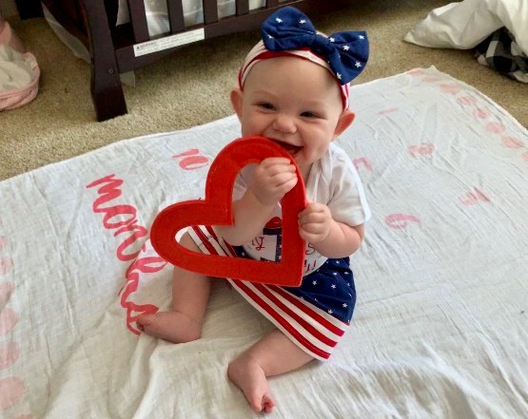

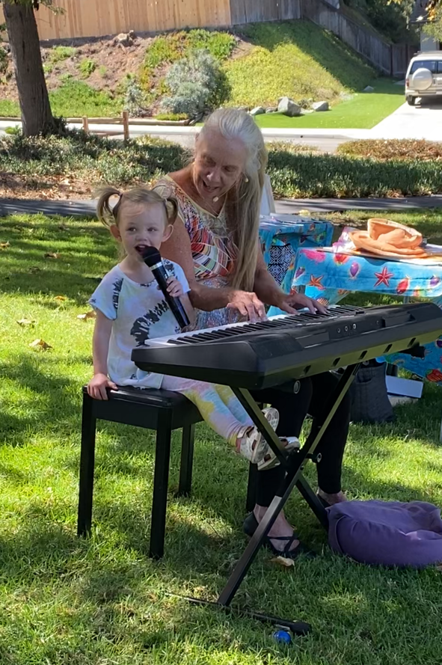
Singing, dancing, playing with puppets, drawing, learning about the fruits of the Spirit at such a young age, will bring the children closer to an understanding of a powerful, loving God, through which his Son, Jesus, not only died for us, but continues to share the fruits of the Spirit with us!
Join the team and let us show you, as volunteers and staff, how much God loves you and your commitment to help these children grow~
Special luncheon for all staff and volunteers will be held this Sunday, January 3rd at 12pm, after church service in your honor! Please come join us and meet some new wonderful friends!
SAVE THE DATE!
Blessings,
Nancy Holden

Slide 18
Additional Resources
Three Recommended Books
Brown, Carolyn C. Raising Children to Love Their Neighbors: Practical Resources for
Congregations. Nashville: Abingdon Press, 2008.
Halverson, Delia Touchton. Children’s Activities for the Christian Year. Nashville: Abingdon Press, 2004.
Mears, Henrietta C. Sunday School Changes Everything. Carol Stream, Ill: Tyndale House Publishers, Inc., 2016.
Three Websites
https://truewaykids.com/
https://sermons4kids.com/
https://www.borntowin.net/

Slide 19
Bibliography
Cockrell, Lee. Creating Magic: 10 Common Sense Leadership Strategies from a Life at Disney. NY: Penguin Random House, 2008.
Idol, Derek. “Married to a Model” (video). https://canvas.liberty.edu/courses/754577/pages/watch-married-to-a-model?module_item_id=82508196.
Joiner, Reggie and Kristen Ivy. It’s Just a Phase So Don’t Miss It: Why Every Life Stage of a Kid Matters and at Least 13 Things Your Church Should Do About It. Cummings, GA: Orange Books, 2015.

